Slide 1
ITNW 1335 Cloud Computing
Chapter 5 – Cloud-Enabling Technology

Slide 2
Cloud-Enabling Technology
Modern-day clouds are underpinned by a set of primary technology components that collectively enable key features and characteristics associated with contemporary cloud computing
Each existed and matured prior to the advent of cloud computing, although cloud computing advancements helped further evolve select areas of these cloud-enabling technologies.

Slide 3
5.1. Broadband Networks and Internet Architecture
All clouds must be connected to a network
This inevitable requirement forms an inherent dependency on internetworking
This allows for the remote provisioning of IT resources and are directly supportive of ubiquitous network access
Consumer can access cloud using only private and dedicated network links
Most clouds are Internet enabled
Potential of clouds grows with advancement of Internet connectivity and service quality
Figure 5.1 Messages travel over dynamic network routes in this ISP internetworking configuration.
Notes:
Figure:

Slide 4
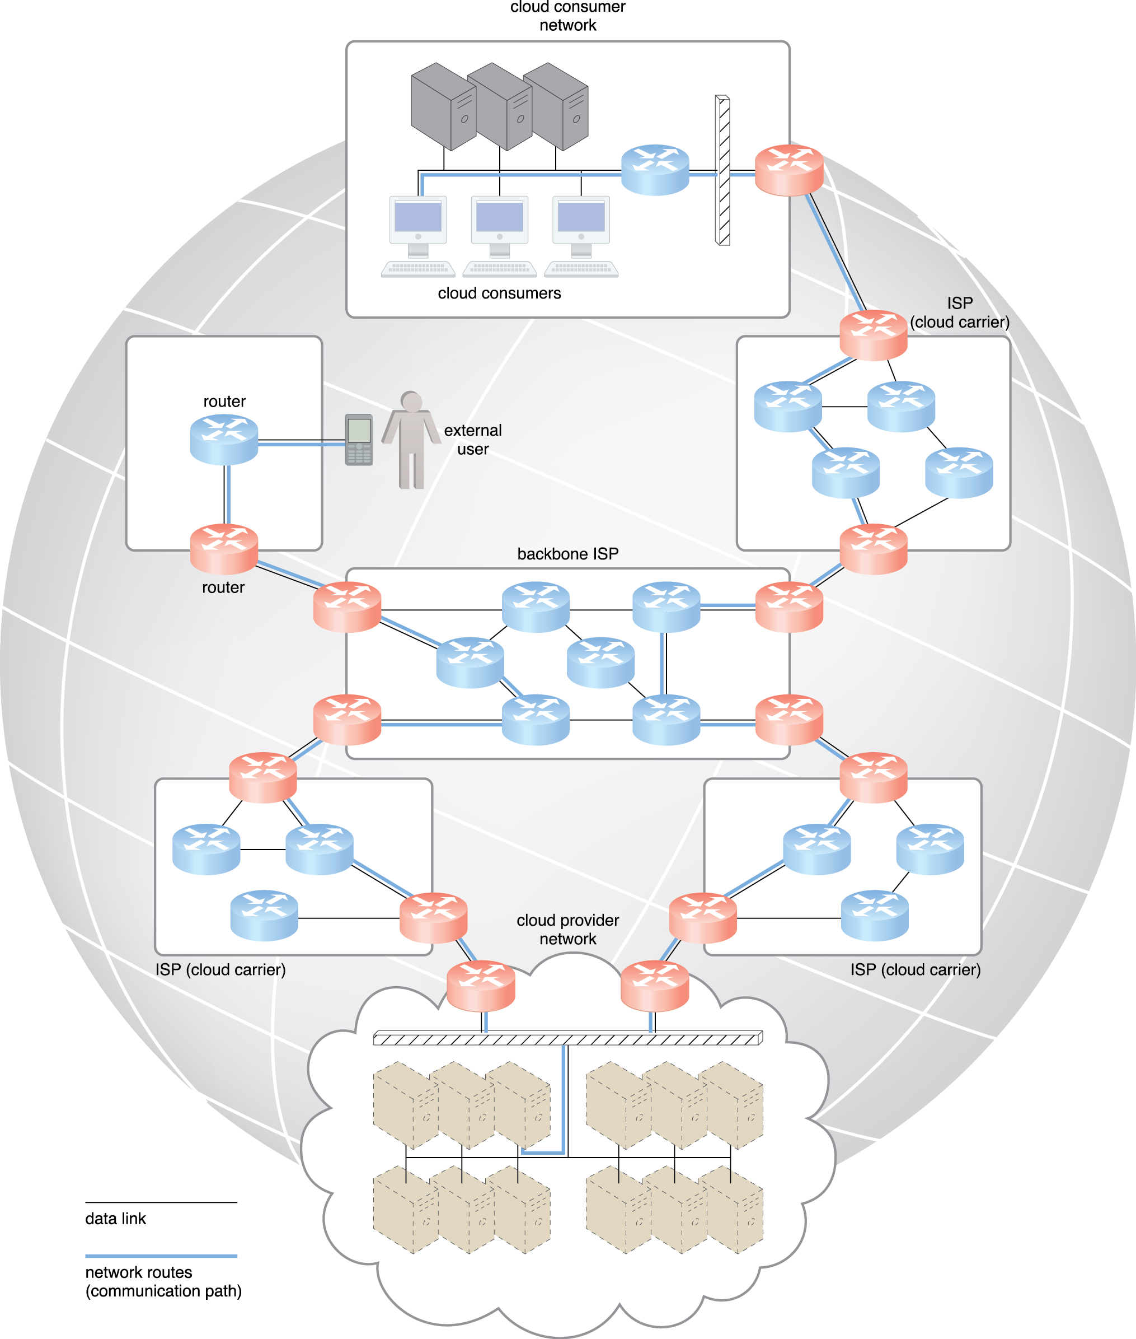
5.1. Internet Service Providers
ISPs provides the Internet’s largest backbone of interconnectivity via core routers
The concept of the Internet was based on a decentralized provisioning and management model
ISPs can freely deploy, operate, and manage their networks in addition to selecting partner ISPs for interconnection
No centralized entity comprehensively governs the Internet, although bodies like the Internet Corporation for Assigned Names and Numbers (ICANN) supervise and coordinate Internet communications
Figure 5.1 Messages travel over dynamic network routes in this ISP internetworking configuration.
Notes:
Figure:

Slide 5
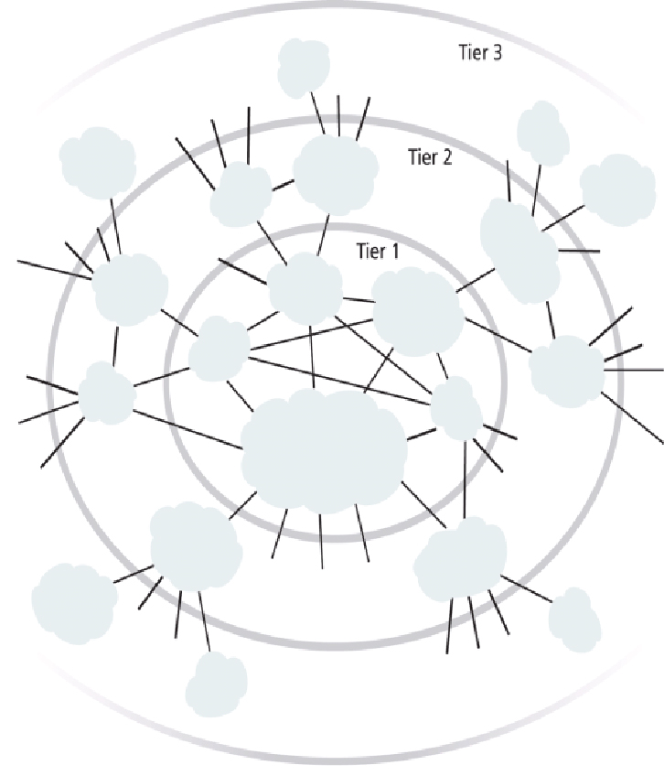
5.1. Internet Service Providers
The Internet’s topology has become a dynamic and complex aggregate of ISPs that are highly interconnected via its core protocols
Smaller branches extend from these major nodes
Worldwide connectivity is enabled through a hierarchical topology composed of Tiers 1, 2, and 3
Tier 1
The core made of large-scale, international cloud providers that oversee massive interconnected global networks, which are connected to Tier 2
Tier 2
Large regional providers. The interconnected ISPs of Tier 2 connect with Tier 1 providers, as well as Tier 3
Tier 3
Local ISPs
Cloud consumers and cloud providers can connect directly using a Tier 1 provider, since any operational ISP can enable Internet connection
Figure 5.2 An abstraction of the internetworking structure of the Internet.
Notes:
Figure:

Slide 6
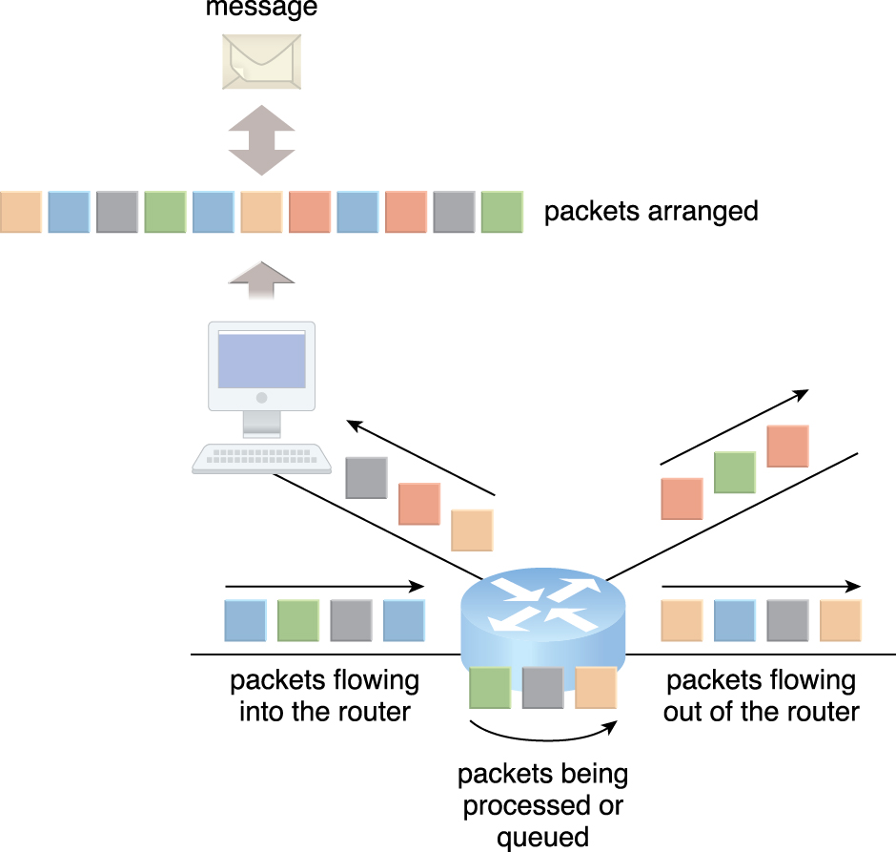
5.1 – Fundamental internetworking components
Two fundamental components used to construct the internetworking architecture:
Connectionless Packet Switching (Datagram Networks)
End-to-end (sender-receiver pair) data flows are divided into packets of a limited size that are received and processed through network switches and routers, then queued and forwarded from one intermediary node to the next
Each packet carries the necessary location information, such as the Internet Protocol (IP) or Media Access Control (MAC) address, to be processed and routed at every source, intermediary, and destination node
Figure 5.3 Packets traveling through the Internet are directed by a router that arranges them into a message.
Notes:
Figure:

Slide 7
5.1 – Fundamental internetworking components
Router-Based Interconnectivity
A router is a device that is connected to multiple networks through which it forwards packets
Even when successive packets are part of the same data flow, routers process and forward each packet individually while maintaining the network topology information that locates the next node on the communication path between the source and destination nodes
Routers manage network traffic and gauge the most efficient hop for packet delivery, since they are privy to both the packet source and packet destination
Notes:
Figure:

Slide 8
5.1 – Fundamental internetworking components
Figure 5.3 Packets traveling through the Internet are directed by a router that arranges them into a message.
Notes:
Figure:

Slide 9
5.1 – Fundamental internetworking components
Failure of an single ISPs infrastructure doesn’t affect cloud access
However, having to access different networks can cause routing fluctuations and latency
This can be caused by:
Physical Network
Physical networks comprise a data link layer that controls data transfer between neighboring nodes, and a physical layer that transmits data bits through both wired and wireless media.
Transport Layer Protocol
End to end communication support using either TCP or UDP using IP to standardize communication
Application Layer Protocol
Protocol like HTTP and SMTP uses transport layer protocols to standardize and enable specific data packet transferring methods over the Internet.

Slide 10
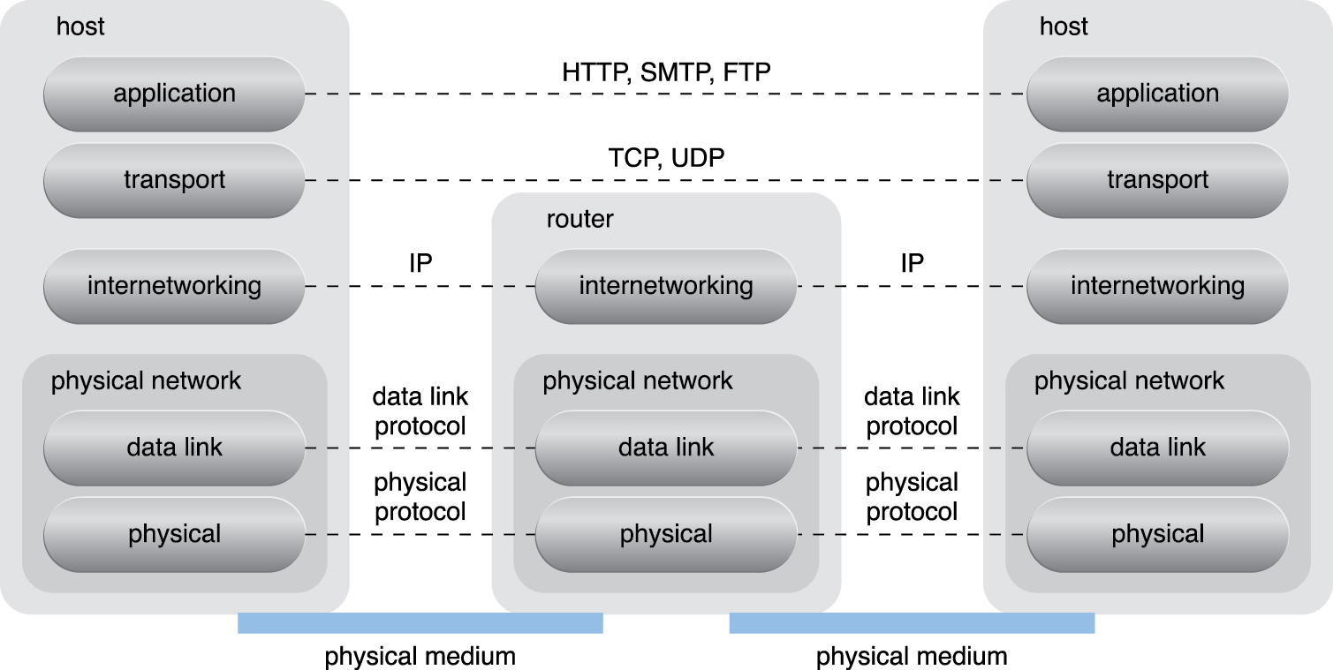
5.1 – Fundamental internetworking components
Figure 5.3 Packets traveling through the Internet are directed by a router that arranges them into a message.
Notes:
Figure:

Slide 11
5.1 - Technical and Business Considerations: Connectivity Issues
In traditional, on-premise deployment models, enterprise applications and various IT solutions are commonly hosted on centralized servers and storage devices residing in the organization’s own data center
End-user devices, such as smartphones and laptops, access the data center through the corporate network, which provides uninterrupted Internet connectivity.
Common implementation for medium and large on-premise networks but not referred to as a cloud model
Organizations can directly access the network traffic to and from the Internet and usually have complete control over and can safeguard their corporate networks using firewalls and monitoring software
Responsible for deploying, operating, and maintaining their IT resources and Internet connectivity
Notes:
Figure:

Slide 12
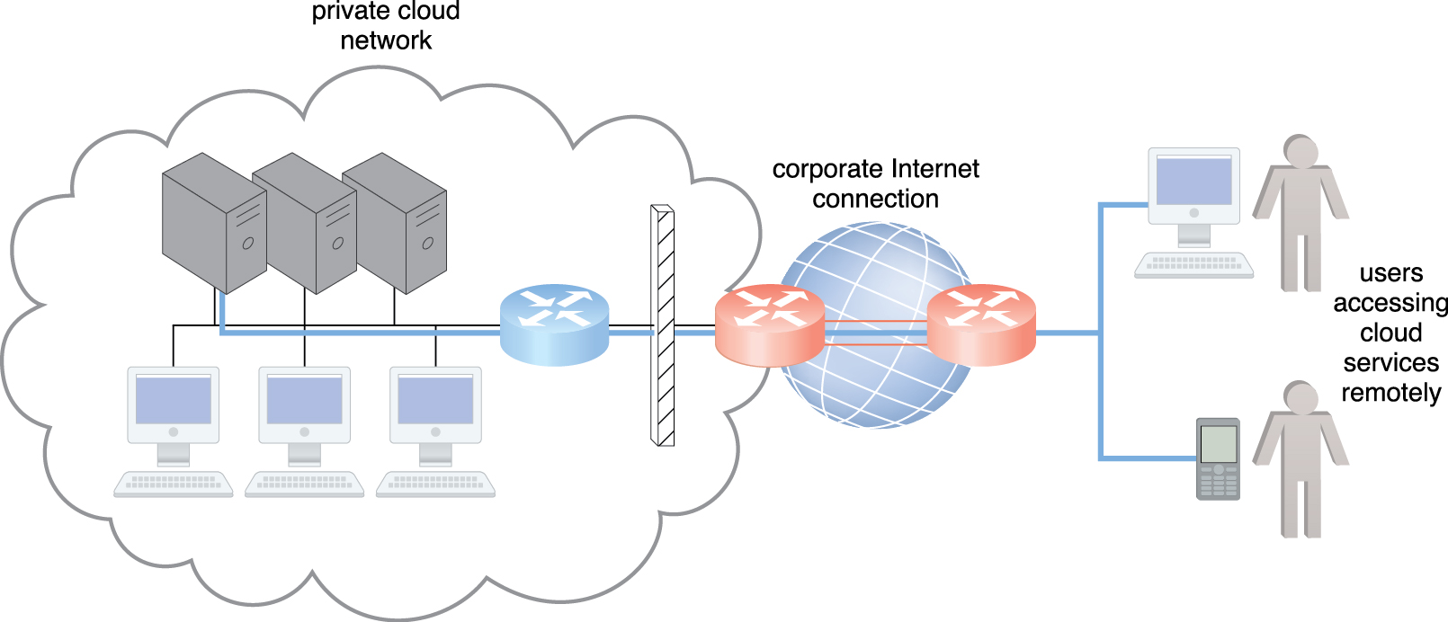
5.1 - Technical and Business Considerations: Connectivity Issues
Figure 5.5 The internetworking architecture of a private cloud. The physical IT resources that constitute the cloud are located and managed within the organization.
Notes:
Figure:

Slide 13
5.1 - Technical and Business Considerations: Connectivity Issues
In another deployment, end-user devices that are connected to the network through the Internet can be granted continuous access to centralized servers and applications in the cloud
Cloud providers can easily configure cloud-based IT resources to be accessible for both external and internal users through an Internet connection
This internetworking architecture benefits internal users that require ubiquitous access to corporate IT solutions
Also benefits cloud consumers that need to provide Internet-based services to external users
Major cloud providers offer Internet connectivity that is superior to the connectivity of individual organizations, resulting in additional network usage charges as part of their pricing model.
Notes:
Figure:

Slide 14
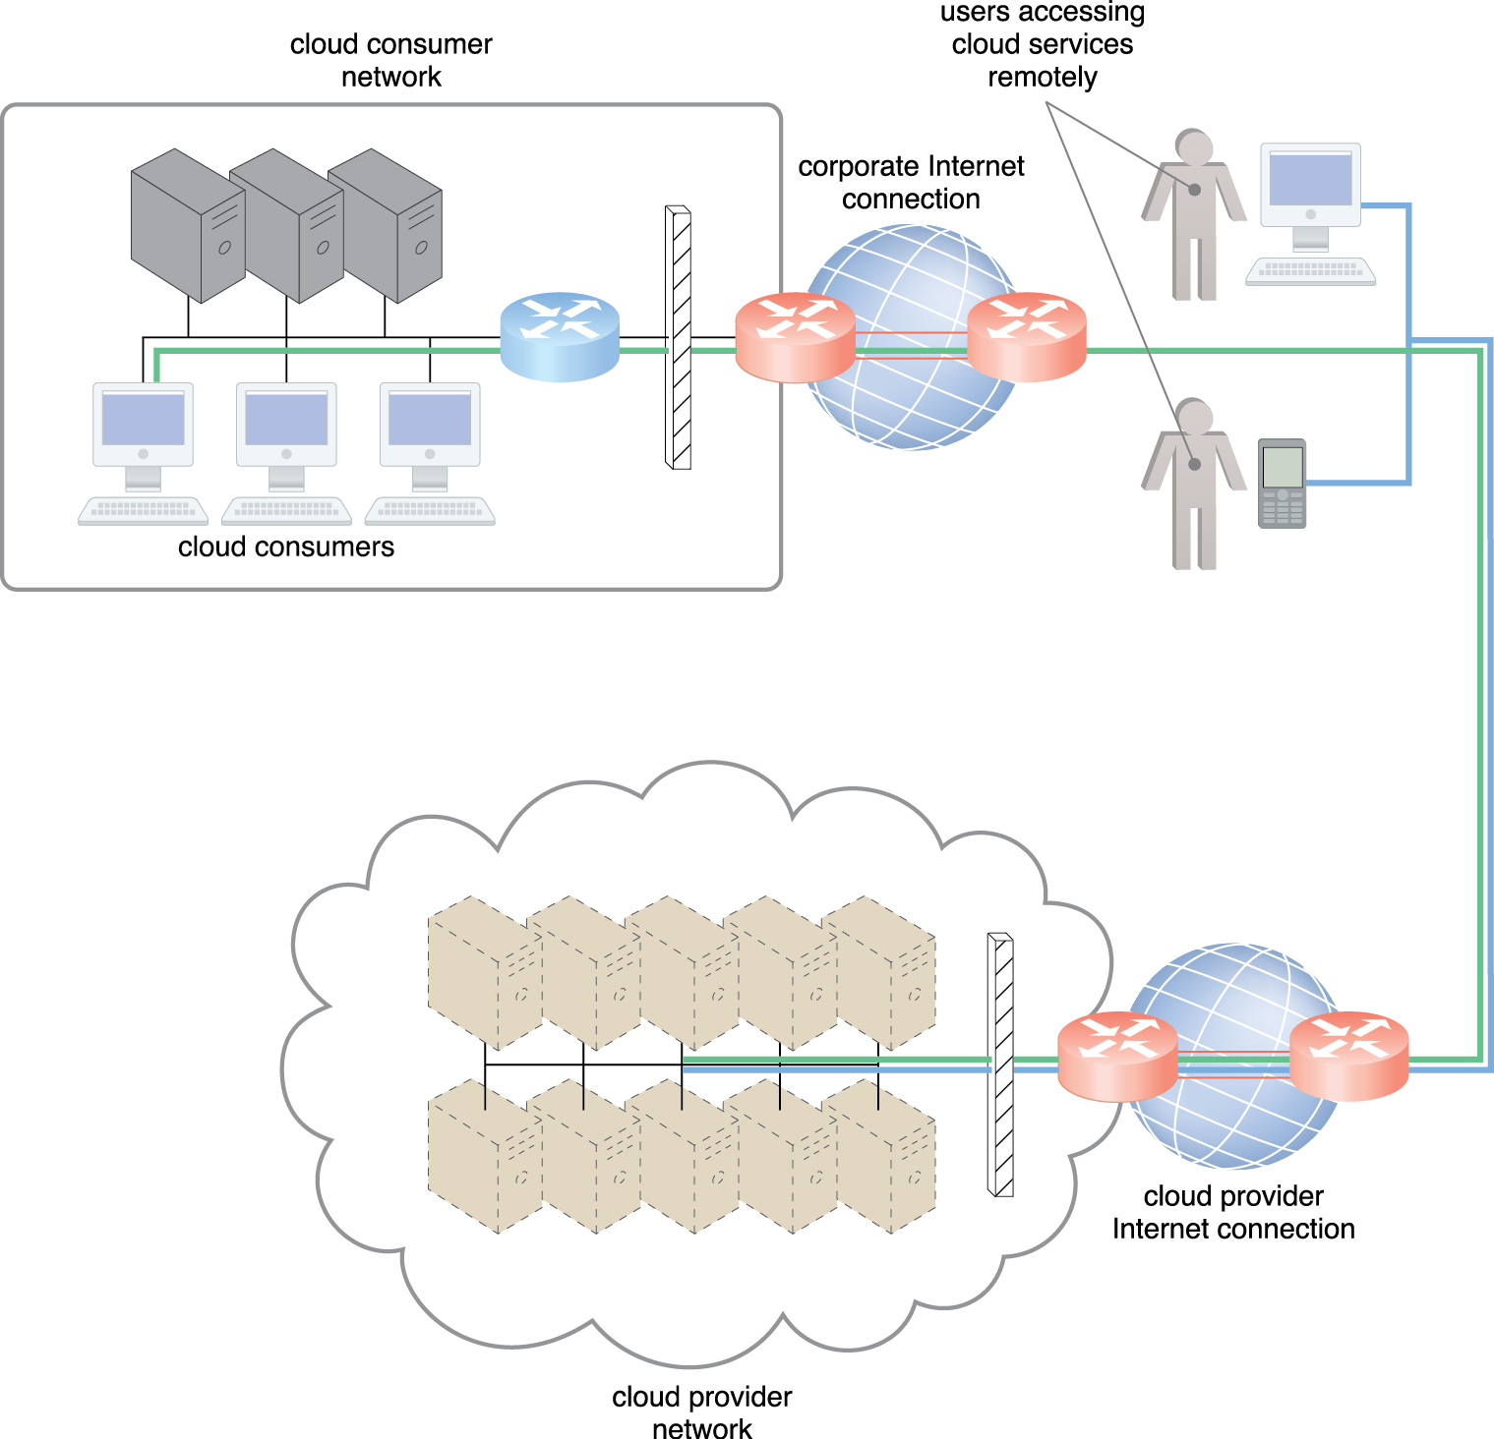
5.1 - Technical and Business Considerations: Connectivity Issues
Figure 5.6 The internetworking architecture of an Internet-based cloud deployment model. The Internet is the connecting agent between non-proximate cloud consumers, roaming end-users, and the cloud provider’s own network.
Notes:
Figure:

Slide 15
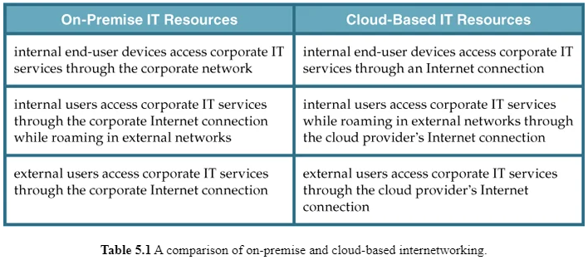
5.1 - Technical and Business Considerations: Connectivity Issues
IT resources in the Cloud can be accessed using the same network protocols regardless of whether they are inside or outside of a corporate network.
Whether IT resources are on-premise or Internet-based dictates how internal versus external end-users access services, even if the end-users themselves are not concerned with the physical location of cloud-based IT resources
Notes:
Figure:

Slide 16
5.1 - Network Bandwidth and Latency Issues
End–to-end Bandwidth is the bandwidth of the data link from network to ISP plus transmission capacity of the shared data links that connect intermediary nodes
ISPs need to use broadband network technology to implement the core network
This type of bandwidth is constantly increasing, with dynamic caching, compression, and pre-fetching, continue to improve end-user connectivity.
Latency(time delay) is the amount of time it takes a packet to travel from one data node to another
increases with every intermediary node on the data packet’s path
Transmission queues in the network infrastructure can result in heavy load conditions
Networks are dependent on traffic conditions in shared nodes, making Internet latency highly variable and often unpredictable.

Slide 17
5.1 - Network Bandwidth and Latency Issues
“Best effort” QoS is packet transfer on a 1st come/1st serve basis
Traffic on congested networks suffer service-level degradation due to:
bandwidth reduction
latency increase
packet loss when traffic is not prioritized.
Because packet switching networks choose paths dynamically, end-to end QoS is affected
IT solutions need to be assessed against business requirements that are affected by network bandwidth and latency, which are inherent to cloud interconnection
Bandwidth is critical for applications that require substantial amounts of data to be transferred to and from the cloud, while latency is critical for applications with a business requirement of swift response times.

Slide 18
5.1 - Cloud Carrier and Cloud Provider Selection
The service levels of Internet connections between cloud consumers and cloud providers are determined by their ISPs
Different due to multiple ISPs in their paths
QoS management across multiple ISPs is difficult to achieve in practice
Cloud consumers and cloud providers may need to use multiple cloud carriers in order to achieve the necessary level of connectivity and reliability for their cloud applications
resulting in additional costs.
Cloud adoption can therefore be easier for applications with more relaxed latency and bandwidth requirements

Slide 19
5.2. Data Center Technology
Grouping IT resources in close proximity with one another, rather than having them geographically dispersed, allows for:
power sharing
higher efficiency in shared IT resource usage
improved accessibility for IT personnel
These are the advantages that made data center popular
Modern data centers exist as specialized IT infrastructure used to house centralized IT resources
servers, databases, networking and telecommunication devices, and software systems

Slide 20
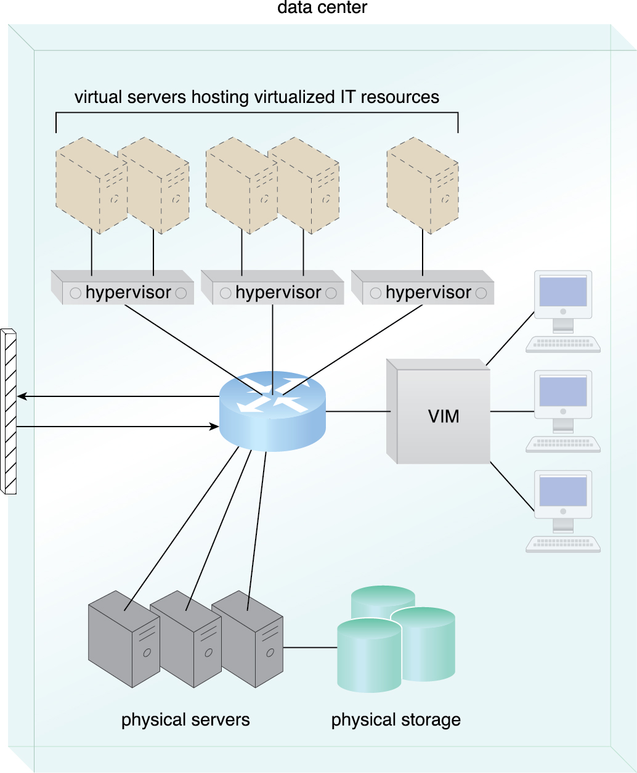
5.2. Data Center Technology - Virtualization
Data centers consist of both physical and virtualized IT resources.
The physical IT resource layer refers to the facility infrastructure that houses computing/networking systems and equipment, hardware systems and their operating systems
The resource abstraction and control of the virtualization layer is comprised of operational and management tools that are easier to allocate, operate, release, monitor, and control the virtual environment.
Figure 5.7 The common components of a data center working together to provide virtualized IT resources supported by physical IT resources.
Notes:
Figure:

Slide 21
5.2. Standardization and Modularity
Data centers are built upon
standardized commodity hardware
designed with modular architectures
aggregating multiple identical building blocks of facility infrastructure
equipment to support
Scalability
Growth
speedy hardware replacements
Modularity and standardization are key requirements for reducing investment and operational costs as they enable economies of scale for the procurement, acquisition, deployment, operation, and maintenance processes

Slide 22
5.2. Standardization and Modularity
Common virtualization strategies, the constantly improving capacity and performance of physical devices favors IT resource consolidation,
fewer physical components are needed to support complex configurations
Consolidated IT resources can serve different systems and be shared among different cloud consumers

Slide 23
5.2. Data Center Technology - Automation
Data centers have specialized platforms that automate (without supervision) tasks like:
Provisioning
Configuration
Patching
monitoring
Advances in data center management platforms and tools leverage autonomic computing technologies to enable self-configuration and self-recovery

Slide 24
5.2. Remote operation & mgmt. – high availability
Most of the operational and administrative tasks of IT resources in data centers are commanded through the network’s remote consoles and management systems
No one need to visit the DC unless it’s hardware related
High Availability is achieved through:
uninterruptable power supplies, cabling, and environmental control subsystems
communication links
clustered hardware for load balancing.

Slide 25
5.2. Data Center Technology - Security-Aware Design, Operation, and Management
Requirements for security in Data Centers need to be thorough and comprehensive for data centers, since they are centralized structures that store and process business data
physical and logical access controls
data recovery strategies
Outsourcing DC operations is common nowadays
Building and operating on-prem DC is expensive
However, the outsourcing models often required long-term consumer commitment and usually could not provide elasticity (via cloud features)

Slide 26
5.2. Data Center Technology - Facilities
Data center facilities are custom-designed locations that are outfitted with specialized computing, storage, and network equipment
These facilities have several functional layout areas, as well as various power supplies, cabling, and environmental control stations that regulate heating, ventilation, air conditioning, fire protection, and other related subsystems
The site and layout of a given data center facility are typically demarcated into segregated spaces

Slide 27
5.2. Data Center Technology - Computing Hardware
Much of the heavy processing in data centers is often executed by standardized commodity servers that have substantial computing power and storage capacity
Several computing hardware technologies are integrated into these modular servers, such as:
rackmount form factor server design composed of standardized racks with interconnects for power, network, and internal cooling
support for different hardware processing architectures, such as x86-32bits, x86-64, and RISC
a power-efficient multi-core CPU architecture that houses hundreds of processing cores in a space as small as a single unit of standardized racks
redundant and hot-swappable components, such as hard disks, power supplies, network interfaces, and storage controller cards

Slide 28
5.2. Data Center Technology - Computing Hardware
Blade server technologies use rack-embedded physical interconnections (blade enclosures), fabrics (switches), and shared power supply units and cooling fans
The interconnections enhance inter-component networking and management while optimizing physical space and power
These systems typically support fault-tolerant features based on clustering
hot-swapping
Scaling
Replacement
Maintenance
Today’s computing HW platforms allows a single operator to oversee thousands of IT Resources

Slide 29
5.2. Data Center Technology - Storage Hardware
Data centers have specialized storage systems that maintain enormous amounts of data
These storage systems houses numerous hard disks that are organized into arrays
Storage systems usually involve the following technologies:
Hard Disk Arrays – These arrays inherently divide and replicate data among multiple physical drives, and increase performance and redundancy by including spare disks.
implemented using redundant arrays of independent disks (RAID) schemes, which are typically realized through hardware disk array controllers.
I/O Caching – This is generally performed through hard disk array controllers, which enhance disk access times and performance by data caching.

Slide 30
5.2. Data Center Technology - Storage Hardware
Storage systems usually involve the following technologies cont.:
Hot-Swappable Hard Disks – allows removal from arrays without requiring prior powering down.
Storage Virtualization – This is realized through the use of virtualized hard disks and storage sharing.
Fast Data Replication Mechanisms
Snapshotting, which is saving a virtual machine’s memory into a hypervisor-readable file for future reloading,
Volume cloning, which is copying virtual or physical hard disk volumes and partitions
Storage systems encompass tertiary redundancies (via tape) of storage direct-attached (DAS) via a HBA or network-attached (NAS)

Slide 31
5.2. Data Center Technology - Storage Hardware
Networked storage devices usually fall into one of the following categories:
Storage Area Network (SAN) – Physical data storage media are connected through a dedicated network and provide block-level data storage access using industry standard protocols, such as the Small Computer System Interface (SCSI).
Network-Attached Storage (NAS) – Hard drive arrays are contained and managed by this dedicated device, which connects through a network and facilitates access to data using file-centric data access protocols like the Network File System (NFS) or Server Message Block (SMB)
NAS, SAN, and other more advanced storage system options provide fault tolerance through
controller redundancy
cooling redundancy
hard disk arrays that use RAID storage technology

Slide 32
5.2. Data Center Technology - Network Hardware
The data center is broken down into five network subsystems in order to enable multiple levels of connectivity
Carrier and External Networks Interconnection
Subsystem usually comprised of backbone routers that provide routing between external WAN connections and the data center’s LAN, as well as perimeter network security devices such as firewalls and VPN gateways
Web-Tier Load Balancing and Acceleration
Subsystem comprises Web acceleration devices, such as XML pre-processors, encryption/decryption appliances, and layer 7 switching devices that perform content-aware routing
LAN Fabric
Internal LAN that provides high-performance and redundant connectivity for all of the data center’s network-enabled IT resources

Slide 33
5.2. Data Center Technology - Network Hardware
LAN Fabric (cont)
Implemented with multiple network switches that facilitate network communications and operate at speeds of up to 10Gbps
Switches can also perform several virtualization functions, such as LAN segregation into VLANs, link aggregation, controlled routing between networks, load balancing, and failover
SAN Fabric
Implementation of storage area networks (SANs) that provide connectivity between servers and storage systems
the SAN fabric is usually implemented with Fibre Channel (FC), Fibre Channel over Ethernet (FCoE), and InfiniBand network switches
NAS Gateways
Subsystem supplies attachment points for NAS-based storage devices and implements protocol conversion hardware that facilitates data transmission between SAN and NAS devices (DWDM)

Slide 34
5.2. Data Center Technology - Other Considerations
IT hardware is subject to rapid technological obsolescence
lifecycles that typically last between five to seven years
The on-going need to replace equipment frequently results in a mix of hardware whose heterogeneity can complicate the entire data center’s operations and management (can be partially mitigated through virtualization)
Security is another major issue when considering the role of the data center
vast quantities of data contained within its doors
Even with extensive security precautions, housing data exclusively at one data center facility means much more can be compromised by a successful security incursion than if data was distributed across individual unlinked components

Slide 35
5.3. Virtualization Technology
Virtualization is the process of converting a physical IT resource into a virtual IT resource.
Most types of IT resources can be virtualized, including:
Servers – A physical server can be abstracted into a virtual server.
Storage – A physical storage device can be abstracted into a virtual storage device or a virtual disk.
Network – Physical routers and switches can be abstracted into logical network fabrics, such as VLANs.
Power – A physical UPS and power distribution units can be abstracted into what are commonly referred to as virtual UPSs.

Slide 36
5.3. Virtualization Technology
The first step in creating a new virtual server through virtualization software is the allocation of physical IT resources
Then the installation of an operating system follows
Virtual servers use their own guest operating systems, which are independent of the operating system in which they were created
Both the guest operating system and the application software running on the virtual server are unaware of the virtualization process
virtualized IT resources are installed and executed as if they were running on a separate physical server.

Slide 37
5.3. Virtualization Technology
Guest operating systems run seamlessly on the VM
Virtualization software runs on the physical server or host
Virtualization software is called Virtual Machine Monitor or Hypervisor
Virtualbox (Oracle)
Hyper-V (Microsoft)
ESX/ESXi (Vmware)
KVM (Linux)

Slide 38
5.3. Virtualization Technology – HW Independence
Hardware-software dependencies can arise with OS/application software configurations in a unique IT hardware platform
In a non-virtualized environment, the operating system is configured for specific hardware models
requires reconfiguration if these IT resources need to be modified
Virtualization is a conversion process that translates unique IT hardware into emulated and standardized software-based copies
hardware independence
virtual servers can easily be moved to another virtualization host automatically
multiple hardware-software incompatibility issues are resolved

Slide 39
5.3. Virtualization Technology – Consolidation
Server consolidation
virtualization software allows multiple virtual servers to be simultaneously created in the same virtualization host
Virtualization technology enables different virtual servers to share one physical server
different virtual servers can run different guest operating systems on the same host
This fundamental capability directly supports common cloud features, such as on-demand usage, resource pooling, elasticity, scalability, and resiliency

Slide 40
5.3. Virtualization Technology – Replication
Virtual servers are created as virtual disk images that contain binary file copies of hard disk content
These virtual disk images are accessible to the host’s operating system, meaning simple file operations (copy, move, paste) can be used to replicate, migrate, and back up the virtual server
This ease of manipulation and replication of virtualization enables
The creation of standardized virtual machine images commonly configured
Increased agility in the migration and deployment of new instances
The ability to roll back (snapshots)
The support of business continuity with efficient backup and restoration procedures

Slide 41
5.3. Virtualization Technology – OS-Based
Operating system-based virtualization is the installation of virtualization software in a pre-existing operating system, which is called the host operating system
Since the host operating system can provide hardware devices with the necessary support, OS virtualization can rectify hardware compatibility issues even if the hardware driver is not available to the virtualization software.
Hardware independence that is enabled by virtualization allows hardware IT resources to be more flexibly used
Notes:
Figure:

Slide 42
5.3. Virtualization Technology – OS-Based
Operating system-based virtualization can introduce demands and issues related to performance overhead such as:
The host operating system consumes CPU, memory, and other hardware IT resources
Hardware-related calls from guest operating systems need to traverse several layers to and from the hardware, which decreases overall performance
Licenses are usually required for host operating systems, in addition to individual licenses for each of their guest operating systems.
Notes:
Figure:

Slide 43
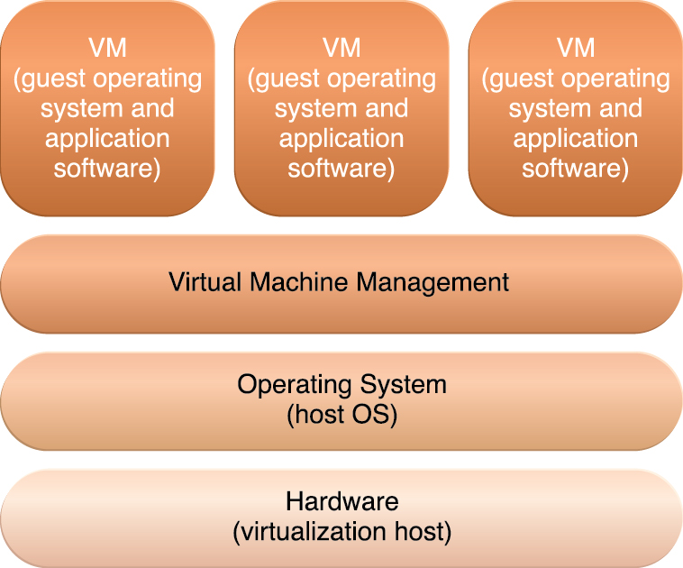
5.3. Virtualization Technology – OS-Based
A concern with OS-based virtualization is the processing overhead required to run the virtualization software and host operating systems
Implementing a virtualization layer will negatively affect overall system performance
Estimating, monitoring, and managing the resulting impact can be challenging because it requires expertise in system workloads, software and hardware environments, and sophisticated monitoring tools
Figure 5.8 The different logical layers of operating system-based virtualization, in which the VM is first installed into a full host operating system and subsequently used to generate virtual machines.
Notes:
Figure:

Slide 44
5.3. Virtualization Technology – Hardware-Based
Represents the installation of virtualization software directly on the physical host hardware so as to bypass the host operating system, which is presumably engaged with operating system-based virtualization
Allowing the virtual servers to interact with hardware without requiring intermediary action from the host operating system generally makes hardware-based virtualization more efficient.
This type of virtualization system is essentially used to optimize performance overhead inherent to the coordination that enables multiple virtual servers to interact with the same hardware platform.
Notes:
Figure:

Slide 45
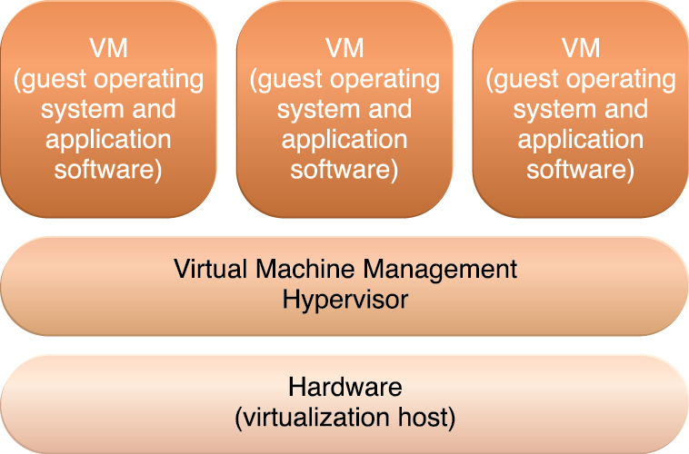
5.3. Virtualization Technology – Hardware-Based
One of the main issues of hardware-based virtualization concerns compatibility with hardware devices
The virtualization layer is designed to communicate directly with the host hardware, meaning all of the associated device drivers and support software need to be compatible with the hypervisor
Hardware device drivers may not be as available to hypervisor platforms as they are to operating systems
Host management and administration features may further not include the range of advanced functions that are common to operating systems
Figure 5.9 The different logical layers of hardware-based virtualization, which does not require another host operating system.
Notes:
Figure:

Slide 46
5.3. Virtualization Technology – Virtualization Mgmt
Many administrative tasks can be performed more easily using virtual servers as opposed to using their physical counterparts
Modern virtualization software provides several advanced management functions that can automate administration tasks and reduce the overall operational burden on virtualized IT resources
Virtualized IT resource management is often supported by virtualization infrastructure management (VIM) tools that collectively manage virtual IT resources and rely on a centralized management module, otherwise known as a controller, that runs on a dedicated computer
VIMs are commonly encompassed by the resource management system mechanism

Slide 47
5.3. Virtualization Technology – Other Considerations
Performance Overhead
Virtualization may not be ideal for complex systems that have high workloads with little use for resource sharing and replication
A poorly formulated virtualization plan can result in excessive performance overhead.
Can use a technique called para-virtualization,
A software interface to the virtual machines that is not identical to that of the underlying hardware
Software interface has been modified to reduce the guest operating system’s processing overhead
A major drawback of this approach is the need to adapt the guest operating system to the para-virtualization API, which can impair the use of standard guest operating systems while decreasing solution portability

Slide 48
5.3. Virtualization Technology – Other Considerations
Special Hardware Compatibility
Many hardware vendors that distribute specialized hardware may not have device driver versions that are compatible with virtualization software
the software itself may be incompatible with recently released hardware versions
These incompatibility can be resolved using mature, established commodities
Portability
The programmatic and management interfaces that establish administration environments for a virtualization program to operate with various virtualization solutions can introduce portability gaps due to incompatibilities
Initiatives such as the Open Virtualization Format (OVF) for the standardization of virtual disk image formats are dedicated to alleviating this concern

Slide 49
5.4. Web Technology – Basic Web
Due to cloud computing’s fundamental reliance on internetworking, Web browser universality, and the ease of Web-based service development, Web technology is generally used as both the implementation medium and the management interface for cloud services
The two basic components of the Web are the Web browser client and the Web server
Other components, such as proxies, caching services, gateways, and load balancers, are used to improve Web application characteristics such as scalability and security
These additional components reside in a layered architecture that is positioned between the client and the server.

Slide 50
5.4. Web Technology – Basic Web
Three fundamental elements comprise the technology architecture of the Web:
Uniform Resource Locator (URL) – A standard syntax used for creating identifiers that point to Web-based resources, the URL is often structured using a logical network location.
Hypertext Transfer Protocol (HTTP) – This is the primary communications protocol used to exchange content and data throughout the World Wide Web. URLs are typically transmitted via HTTP.
Markup Languages (HTML, XML) – Markup languages provide a lightweight means of expressing Web-centric data and metadata.
HTML: used to express the presentation of Web pages
XML: allows for the definition of vocabularies used to associate meaning to Web-based data via metadata
Web resources are represented as hypermedia as opposed to hypertext, meaning media such as graphics, audio, video, plain text, and URLs can be referenced collectively in a single document.

Slide 51
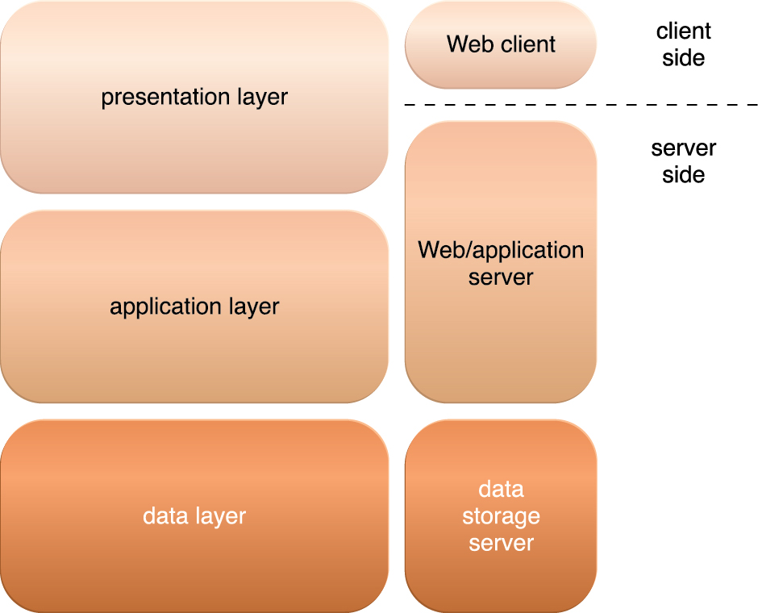
5.4. Web Technology – Web Application
A distributed application that uses Web-based technologies (and generally relies on Web browsers for the presentation of user-interfaces) is typically considered a Web application
A common architectural abstraction for Web applications is based on the basic three-tier model.
The first tier is called the presentation layer, which represents the user-interface.
The middle tier is the application layer that implements application logic
The third tier is the data layer that is comprised of persistent data stores.
Figure 5.10 The three basic architectural tiers of Web applications.
Notes:
Figure:

Slide 52
5.5. Multitenant Technology
Multitenant application design was created to enable multiple users (tenants) to access the same application logic simultaneously
Each tenant has its own view of the application that it uses, administers, and customizes as a dedicated instance of the software while remaining unaware of other tenants that are using the same application
Multitenant applications ensure that tenants do not have access to data and configuration information that is not their own
Multitenant application architecture is often significantly more complex than that of single-tenant applications.

Slide 53
5.5. Multitenant Technology
Tenants can individually customize
User Interface – Tenants can define a specialized “look and feel” for their application interface
Business Process – Tenants can customize the rules, logic, and workflows of the business processes that are implemented in the application
Data Model – Tenants can extend the data schema of the application to include, exclude, or rename fields in the application data structures
Access Control – Tenants can independently control the access rights for users and groups.

Slide 54
5.5. Multitenant Technology – Application Characteristics
Usage Isolation – The usage behavior of one tenant does not affect the application availability and performance of other tenants
Data Security – Tenants cannot access data that belongs to other tenants
Recovery – Backup and restore procedures are separately executed for the data of each tenant
Application Upgrades – Tenants are not negatively affected by the synchronous upgrading of shared software artifacts
Scalability – The application can scale to accommodate increases in usage by existing tenants and/or increases in the number of tenants
Metered Usage – Tenants are charged only for the application processing and features that are actually consumed
Data Tier Isolation – Tenants can have individual databases, tables, and/or schemas isolated from other tenants. Alternatively, databases, tables, and/or schemas can be designed to be intentionally shared by tenants.

Slide 55
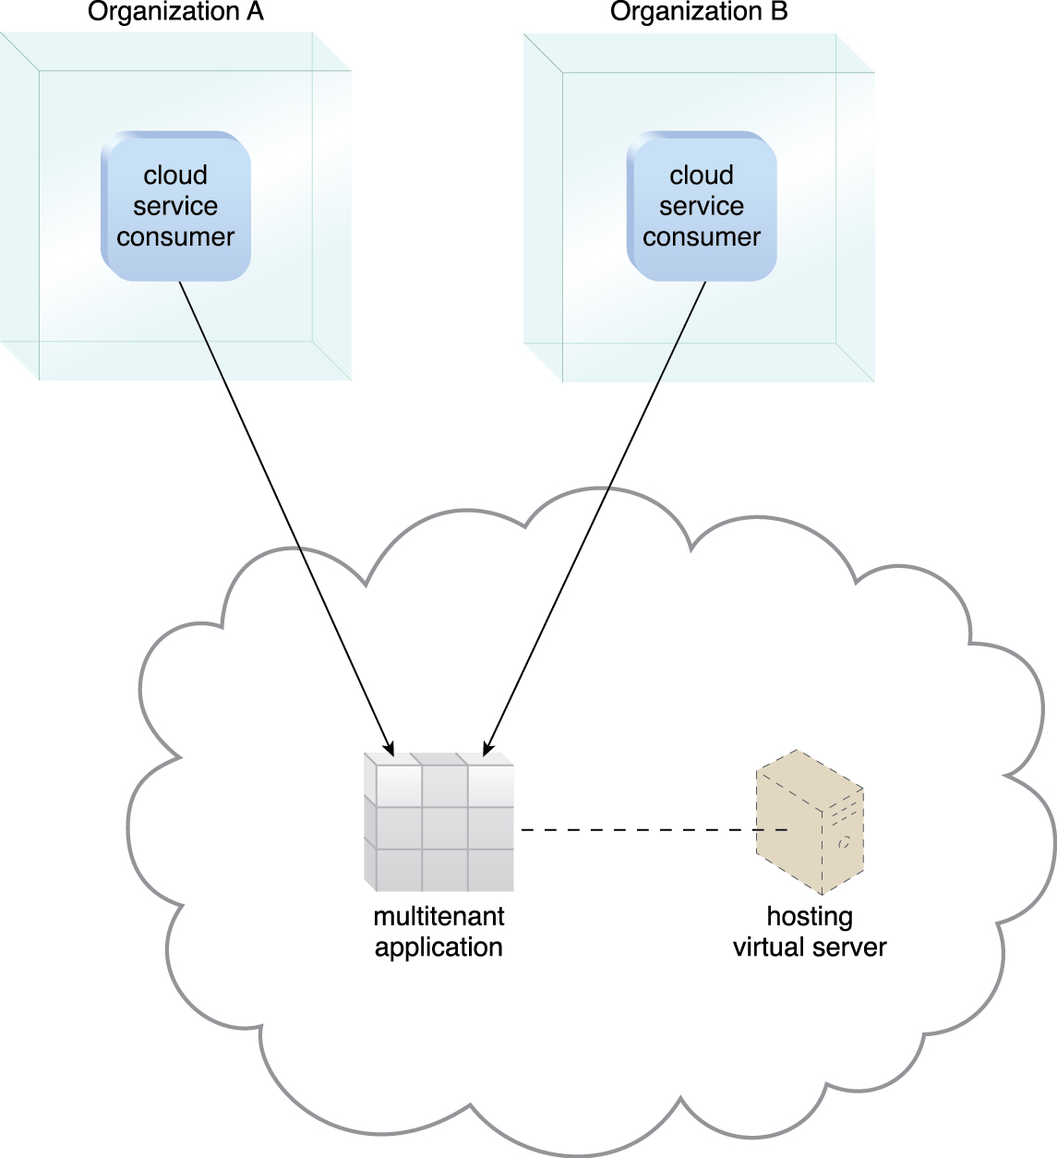
5.5. Multitenant Technology
Figure 5.11 A multitenant application that is serving multiple cloud service consumers simultaneously.
Notes:
Figure:

Slide 56
5.6. Containerization
Containerization is an operating system-level virtualization technology used to deploy and run applications and cloud services without the need to deploy a virtual server for each solution
Instead, they are deployed within containers
Using containers enables multiple isolated cloud services to run on a single physical server or virtual server while accessing the same operating system kernel
The operating system kernel allows for the existence of multiple isolated user-space instances or multiple isolated runtimes known as containers, partitions, virtual engines, jails or chroot jails

Slide 57
5.6. Containerization - Containerization Vs. Virtualization
A cloud service running on a physical or virtual server operating system can see all of the provided resources, such as connected devices, ports, files, folders, network shares, CPUs, as well as the physical addressable memory
However, a cloud service running inside a container can only see the container’s contents and devices attached to the container.
Virtualization refers to the act of creating a virtual, rather than an actual version of something
This includes virtual computer hardware platforms, storage devices, and computer network resources
Virtual servers are an abstraction of physical hardware via server visualization and the use of hypervisors for abstracting a given physical server into multiple virtual servers

Slide 58
5.6. Containerization - Containerization Vs. Virtualization
Containers are an abstraction at the application or service layer that package code and dependencies together
Multiple containers can be deployed on the same machine and share an operating system kernel with other containers
Each container runs as an isolated process in the user space
Containers do not require the guest operating system that is needed for virtual servers and can run directly on a physical server’s operating system

Slide 59
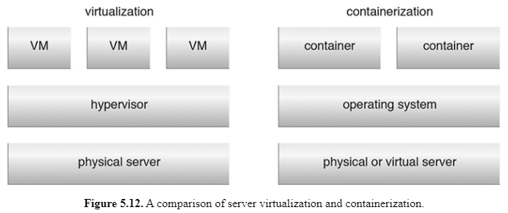
5.6. Containerization - Containerization Vs. Virtualization
Notes:
Figure:

Slide 60
5.6. Containerization – Benefits of containers
Portability is one of the key benefits of containers
Allows cloud resource administrators to move containers to any environment that shares the same host operating system and container engine that the container is hosted on, and without the need to change the application or software (which would normally require changes to the source code)
Efficient resource utilization is achieved by significantly reducing the CPU, memory and storage usage footprint compared to virtual servers
Containers can be created and deployed much faster than virtual servers, which supports a more agile process and facilitates continuous integration

Slide 61
5.6. Containerization - Container Hosting and Pods
A single process of one cloud service is normally deployed in each container,
though more than one cloud service or process can be deployed in each
In some cases, one core process and its side processes or extra functions are deployed in the same container
Container resources consumption can be restricted or limit visible external IT resources
Cloud services deployed in a container normally share the same lifecycle with the container
deployed cloud service will start, stop, pause or resume when the container does

Slide 62
5.6. Containerization - Container Hosting and Pods
Multiple containers can be deployed in a logical construct called a pod
A pod is a group of one or more containers that have shared storage and/or network resources, and also share the same configuration that determines how the containers are to be run
A pod is typically employed when there are different cloud services that are part of the same application or namespace and that need to run under a single IP address
Pod establishes this environment, while ensuring that cloud services can be isolated so that they don’t impact each other’s runtime

Slide 63
5.6. Containerization - Fundamental Container Architecture Elements
Container Engine
The key component of container architecture
Specialized software that is deployed in an operating system to abstract the required resources and enable the definition and deployment of containers
Software can be deployed on physical machines or virtual machines
Each container engine provides a set of management tools and commands/APIs to create, modify, schedule, run, stop, start or delete the containers
Container Build File
a descriptor (created by the user or service) that represents the requirements of the application and services that run inside the container, as well as the configuration parameters required by the container engine in order to create and deploy the container

Slide 64
5.6. Containerization - Fundamental Container Architecture Elements
Container Image
deployed image based on pre-defined requirements
Based on the defined descriptions, the container engine customizes the operating system image and the required commands or services for the application.
An immutable read-only image, which enables the deployed application or services in the container to function and perform tasks, but prevents any changes from being made
Container
an executable instance of a pre-defined or customized container image that contains one or more software programs, most commonly an application or service.
Isolated from other container
May be required to access a shared resource over the network

Slide 65
5.6. Containerization - Fundamental Container Architecture Elements
Container (cont.)
Each container may have one application or process running in it
Containers can also host multiple applications, services or processes
Applications started and stopped with the container
Networking
Each container has its own network address (such as an IP address) used to communicate with other containers and external components
A container can be connected to more than one network by allocating additional network addresses to the container
use the physical or virtual network card of the system that the container engine is deployed on to communicate with other containers and IT resources

Slide 66
5.6. Containerization - Fundamental Container Architecture Elements
Storage Device
a container may connect to one or more storage devices that are made available to the containers over the network
Each container has its own level of access to the storages defined by the system or administrators.

